Slide 1







Mischka van Wyk
IWA19
Final Capstone Presentation
Presentation

Slide 2


Purpose of the Final Capstone Project
Showcase skills and demonstrate ability to troubleshoot and improve existing code.
Express the product behaviour as intended.
Fix all critical issues, as well as do a full audit of the existing code

Slide 3
Solutions I made use of .
Used let, const and global variables in my code, let for variables I wanted to modify, const for varibles I wanted to stay constant and a global variable to use from any part of a program.
Declared functions to avoid it being repeated.
Creating constants for all data objects.
Writing the code in the order of user satisfactory, from stories 1-8.

Slide 4
Challenges faced.
Limited time to complete final project.
Initial difficulty understanding JavaScript
I had to find other reading and video materials to gain more knowlege and confidence in completing this project.
Had to revisit my code in order to remove error meassages and missed brackets or missed code.
Overall JavaScript itssef, however I found more confidence and overcame certain challenges with room for more improvement.

Slide 5
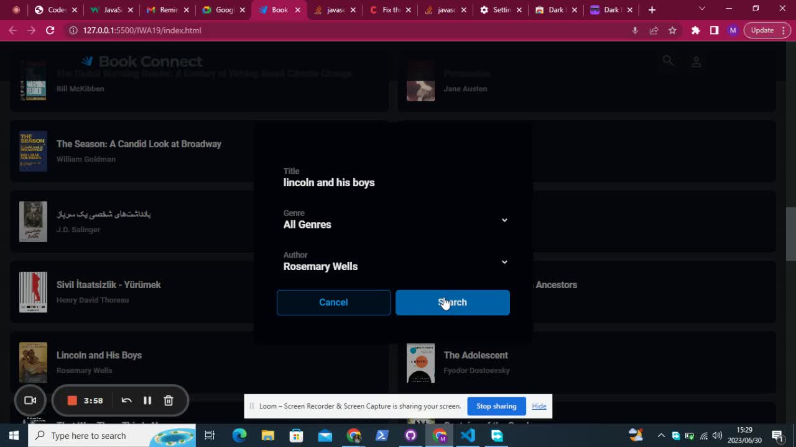
Sort Demo of Code working in the browser

Slide 6

Thank You

